Slide 1
Power System Dynamics and Stability
Chapter 11
Power System Toolbox (PST)
© 2017 Peter W. Sauer, M. A. Pai, and Joe H. Chow, All Rights Reserved

Slide 2
Outline
PST is a MATLAB-based open-source positive-sequence power system simulation program
Three main capabilities
Power flow solution with sparse factorization
Dynamic simulation for transient stability and small signal stability analysis
Linearization to generate (A,B,C,D) matrices for system mode calculation and power system control design
Basic generator, exciter, and PSS models
Topics
Data requirement for power system power flow solution and dynamic simulation
Structures of PST (similar to commercial programs)
Simulation examples
Reinforcement of materials discussed in the other chapters

Slide 3
Power Flow Data
System base: typically 100 MVA or 1000 MVA
Bus data
Generator: desired active power generation in pu, reactive power limits
Load: active and reactive power loads in pu
Shunt capacitor/reactor in pu
kV and desired voltage range values
Branch data
Line data: resistance (R), reactance (X), and line charging (B) - all in pu
Transformer data: resistance (usually neglected) and (leakage) reactance in pu, tap ratios, and variable taps if tap-changing transformer
Phase-shifting transformer data: variable taps
Practical system data
High voltage transmission lines have lower values of R and X, but higher values of B, compared to lower voltage transmission lines, on same pu base
Longer lines have higher (R, X, B) values
Underground cables have higher B than overhead transmission lines (why?)
Transformer leakage reactance is about 15% on its own MVA base
Taps are adjusted if the controlled bus voltage is below or above the desired range.

Slide 4
Power Flow Formulation and Solution
Power flow bus types (also see Section 7.3)
Solution methods
Gauss-Seidel method: not used because of linear convergence; except possibly for initialization
Newton-Raphson method: fast and efficient iterative approach
Uses admittance matrix (Y) to formulate power flow equations
Because Y is sparse, the Jacobian (J) formed at each iteration is also sparse, allowing the use of a sparse LU decomposition to solve for the updates to the solution. Sparse factors can be reused.
Warm start from a related solution improves convergence vs cold start with bus angles equal 0
Convergence may be improved using the decoupled or dishonest power flow methods

Slide 5
Power Flow Example – 2-Area System

Slide 6
Power Flow Example – 2-Area System with Base Load

Slide 7
2-Area System with Increased Load on Bus 13
Active power load on Bus 13 increased to 16.75 pu
Generator maximum reactive power output set to 2 pu
Generator on Bus 12 reaches reactive limit and switched to a PQ bus. Note the voltage on Bus 12 drops to 1.0076 (from 1.01 pu)

Slide 8
Nonconvergent Power Flow
Mostly because there is no feasible power flow solution for the given data set Possible data issues:
Incorrect MVA base used for bus, branch, and generator data
Line reactance values too high, not permitting enough active power to flow
Voltage problems
Perhaps most common when first setting up a new power flow data set
Insufficient reactive power to support bus voltages to within the desired ranges
Increase the generator bus voltage magnitude so that generators can output larger amount of reactive power
Add shunt capacitors or synchronous condensers to selective buses. If a power flow solution list the buses with low voltages, add shunt capacitors to those buses.

Slide 9
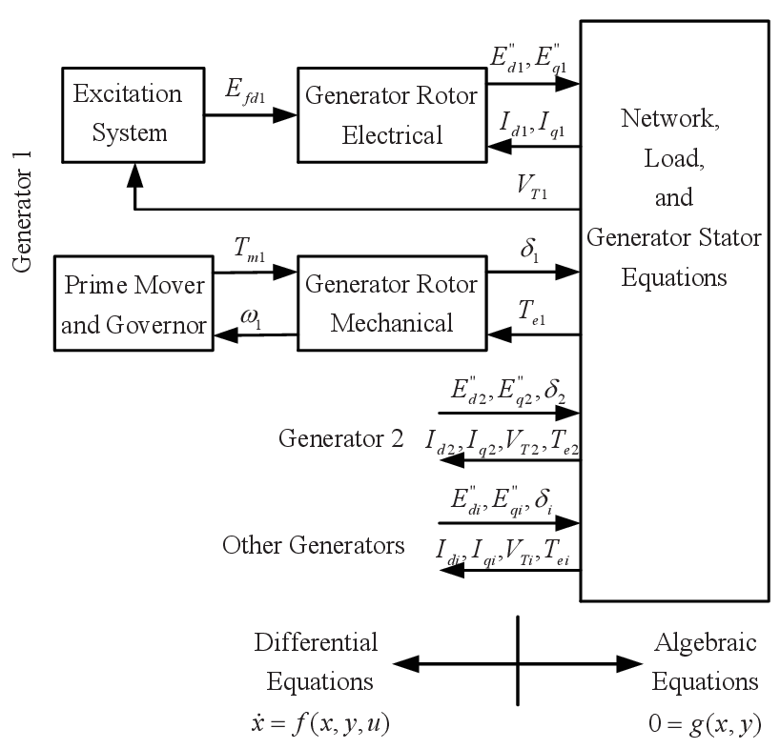
Dynamic Simulation
Simulate the impact of a disturbance in a power system using dynamic models of generators, exciters, governors, and control equipment, which are interconnected via the power network
Interactions of variables shown in the figure to the right (from W. W. Price)
Simulation uses both differential equations (for machine dynamics, etc.) and algebraic equations (for the power network in which electromagnetic transients are neglected) . Thus the “staging” of the simulation process is important.

Slide 10
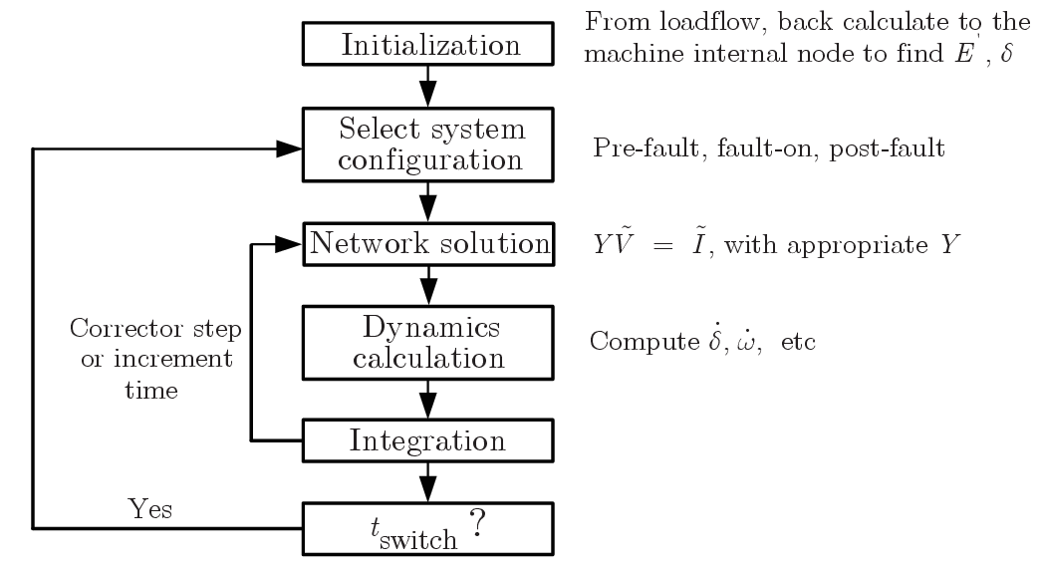
Dynamic Simulation Flowchart
Main requirements
Initialization
Network solution
Dynamics calculation
Integration
Simulation management
Configuration selection
Time increment

Slide 11
Dynamic Model Data
Dynamic models for power system equipment are presented in earlier chapters.
Standard dynamic models have been developed for various generators, turbine-governors, and excitation systems. Manufacturers will provide data for appropriate models.
Manufacturer’s data on the equipment’s rating are normally entered as model parameters. Computer code will handle base conversion.
Practical power equipment parameters given on the equipment rating are normally within certain ranges, because the designs are based on physical laws. For example, inertias of generators range from 2.5 pu for hydraulic units (single water wheel) to 6.0 for steam units (with many turbine sections), when put on their own MVA base. The transient reactance is normally between 0.2 to 0.3 pu (as limited by rotor and stator magnetics).
It is helpful to look for abnormal parameters in the data set, such as large and small time constants and reactances, and determine whether they are appropriate.

Slide 12
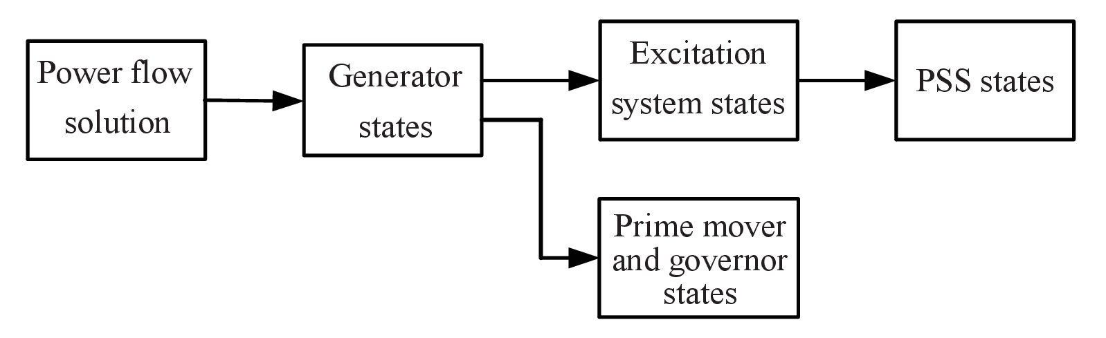
Initialization
Power system dynamic simulation should start from a steady-state solution before a disturbance is applied.
The steady-state solution for the power network is determined by the power flow equations, as a function of the specified generation and load.
Each generator uses the terminal voltage and (P,Q) values to initialize its internal states (also see Section 7.6.3 for the generator voltage-current phasor diagram).
The generator states will be used to initialize the excitation systems and separately the turbine states.
PSS state initialization follows that of the excitation system.

Slide 13
Network Solution
In the power flow calculation, the network current flow is determined based on fixed voltages at generator terminal buses, with the assumption that the excitation systems can be set to control these voltages at desired values
In a disturbance simulation, an excitation system’s ability to maintain the terminal voltage depends on its gains and time constants
Thus in the transient period, an excitation system will adjust the field voltage to restore the terminal bus voltage
In essence, the fixed voltages are now inside the generator (involving also the rotor angle), not at the generator terminal bus
Thus the network current flow calculation needs to involve the machine reactances
The sequencing is as follows:
Use the machine internal voltages to solve for the currents in the “extended” network
Use the generator currents to determine the electrical power provided by the generators

Slide 14
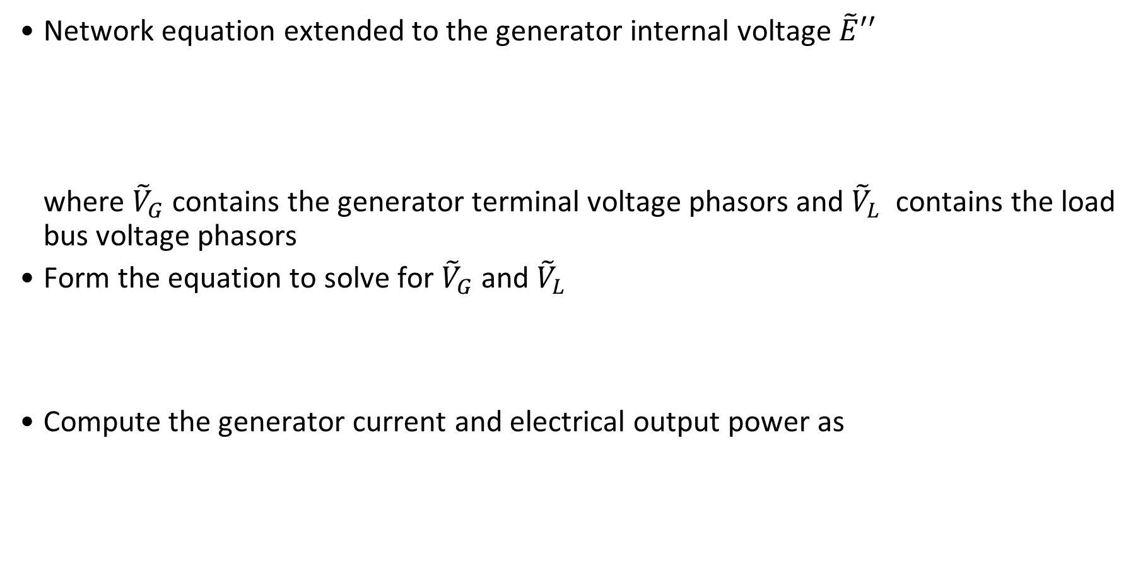
Network Equations
Network equation extended to the generator internal voltage $\tilde{E}′′$ where ${\tilde{V}}_{G}$ contains the generator terminal voltage phasors and ${\tilde{V}}_{L}$ contains the load bus voltage phasors
Form the equation to solve for ${\tilde{V}}_{G}$ and ${\tilde{V}}_{L}$
Compute the generator current and electrical output power as

Slide 15
Integration Method
Nonlinear differential equations
Discrete-time states
Euler full-step modification method – requires two calculations per integration step
Predictor step
Corrector step
This method is a second-order method, with the local truncation error
Some commercial programs use the multi-step Adams-Bashforth Second-Order (AB2) method, which requires only one calculation per integration step

Slide 16
Disturbance Script
The reliability of a power system is assessed based on its ability to withstand all credible N-1 contingencies
User of a dynamic simulation program needs to provide the specifications of the disturbance, via a “script,” which consists of
Start time (normally 0 sec)
Time to apply the fault (0.1 to 1 sec)
Type of fault: 3-phase-to-ground short-circuit fault, line-to-line-to-ground, line-to-ground, impedance to ground
Location of fault
Fault clearing time (typically 4-6 cycles), with or without line removal
End time (10-20 sec)
Common to use 3-phase-to-ground short-circuit fault, as it is usually the most severe fault
Integration step size can be changed during the simulation: smaller step size during the fault-on period, and larger step size when the transient has mostly settled

Slide 17
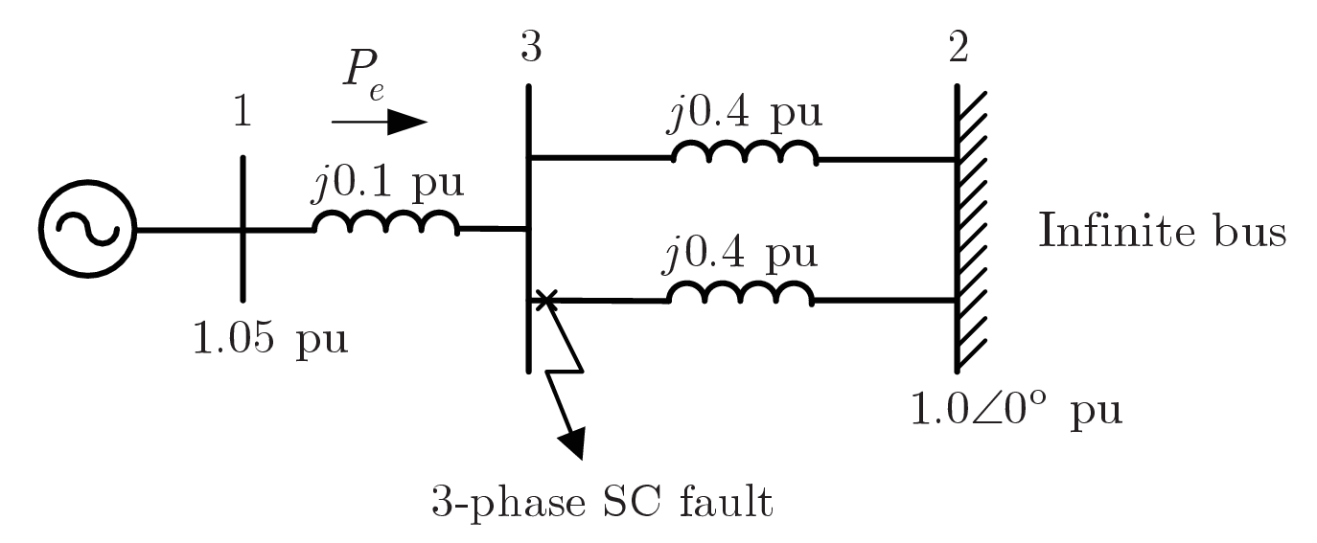
Example 11.3
Simulate the power system subject to the 3-phase-to-ground short-circuit fault close to Bus 3, and cleared by removing the faulted line
6-cycle fault (stable)
9-cycle fault (unstable)

Slide 18
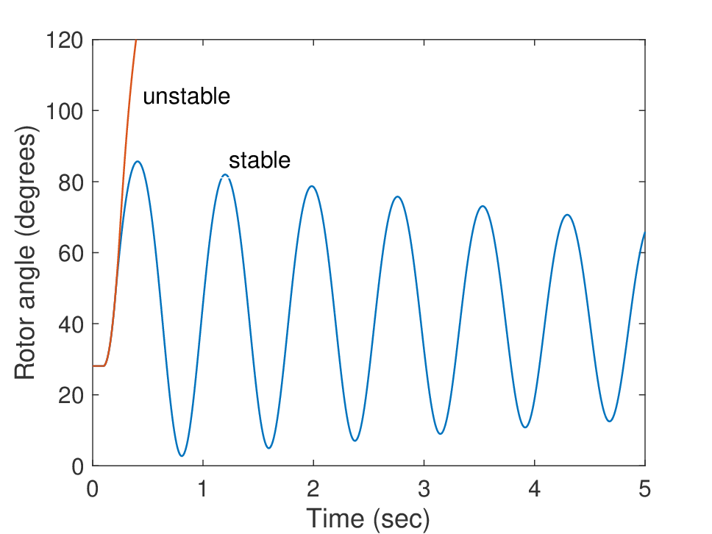
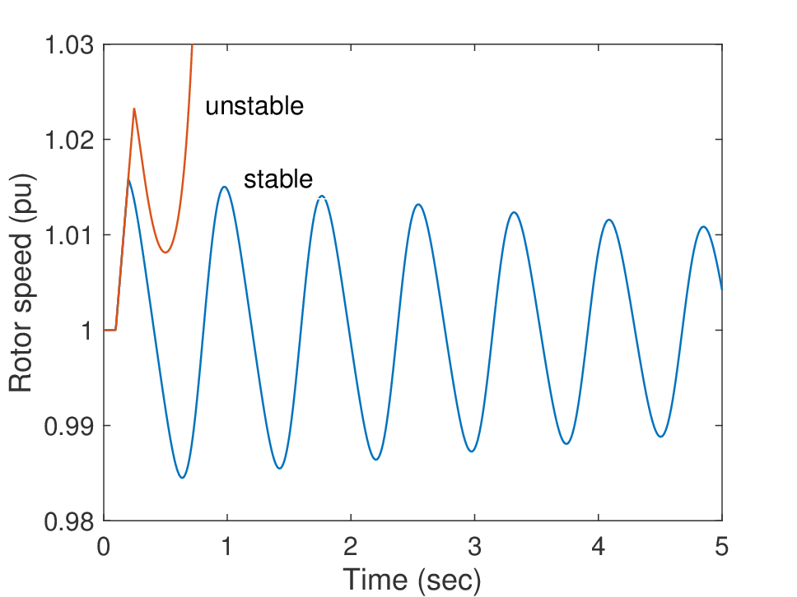
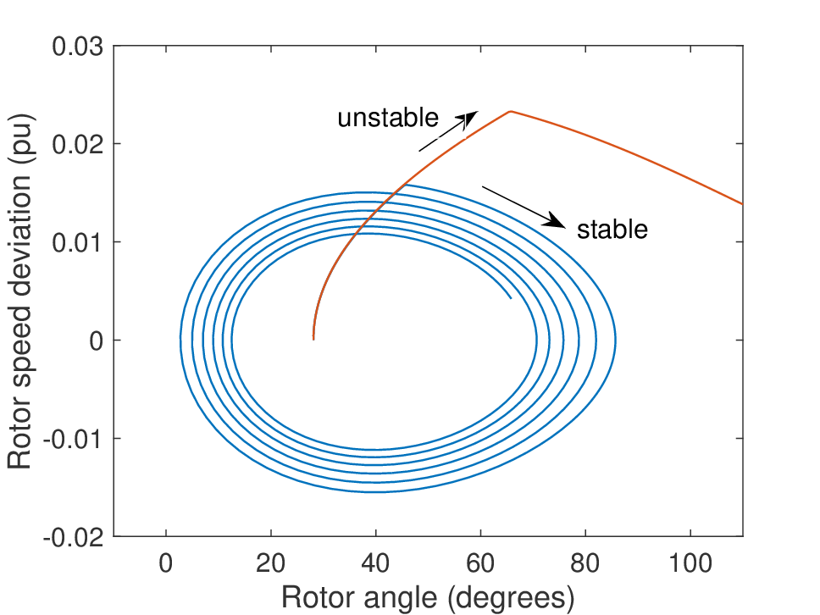
Example 11.3: System Response
6-cycle fault (stable) – blue trajectory
9-cycle fault (unstable) – red trajectory

Slide 19
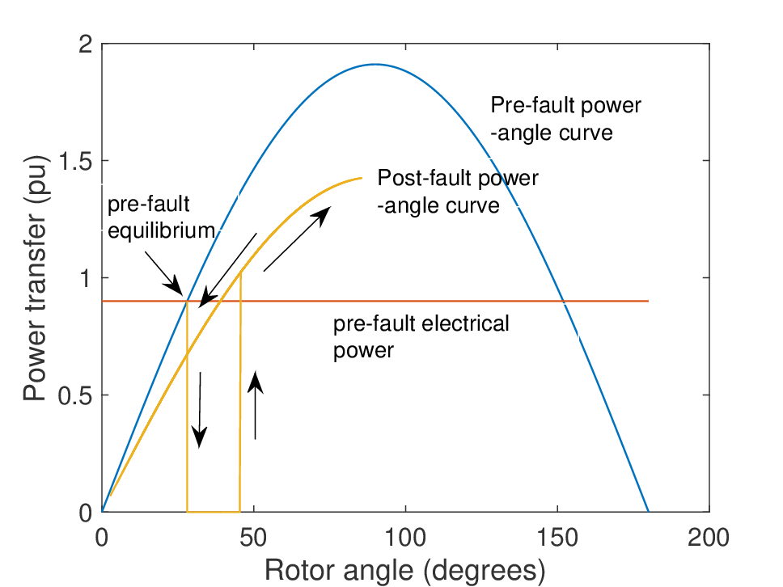
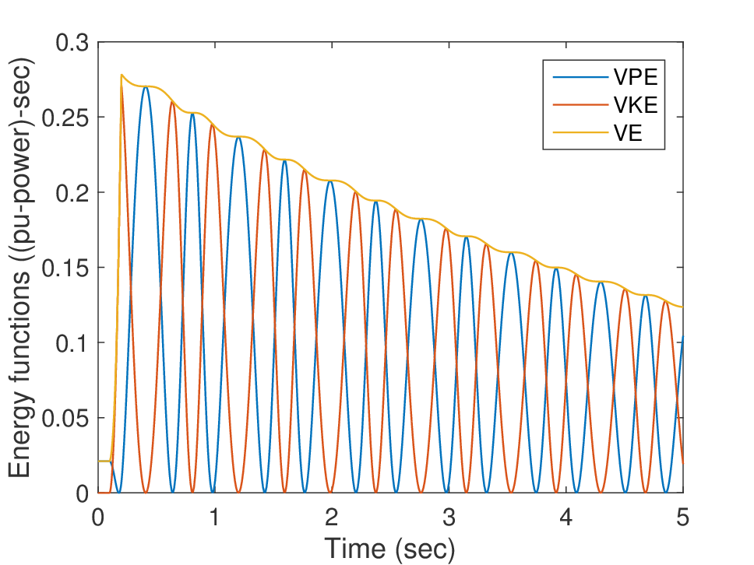
Example 11.3: P-$δ$ Curve and Energy Functions
For the 6-cycle fault (stable) trajectory

Slide 20
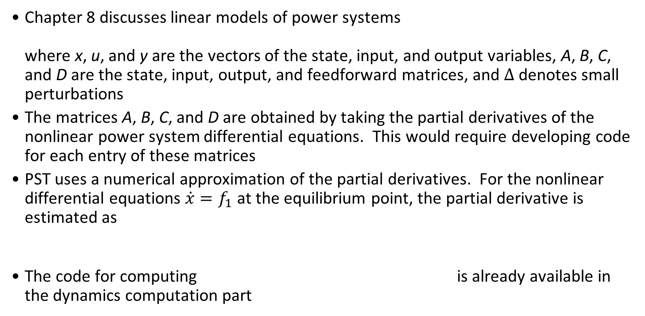
Linear Analysis
Chapter 8 discusses linear models of power systems where x, u, and y are the vectors of the state, input, and output variables, A, B, C, and D are the state, input, output, and feedforward matrices, and $∆$ denotes small perturbations
The matrices A, B, C, and D are obtained by taking the partial derivatives of the nonlinear power system differential equations. This would require developing code for each entry of these matrices
PST uses a numerical approximation of the partial derivatives. For the nonlinear differential equations $\dot{x}=f_{1}$ at the equilibrium point, the partial derivative is estimated as
The code for computing is already available in the dynamics computation part

Slide 21
Linear Analysis Example
Develop the linear model of the single-machine infinite-bus system used in Example 11.3 (slide 17), find the linearized model using the PST function svm_mgen
Linear model
States
System matrix (a_mat)

Slide 22
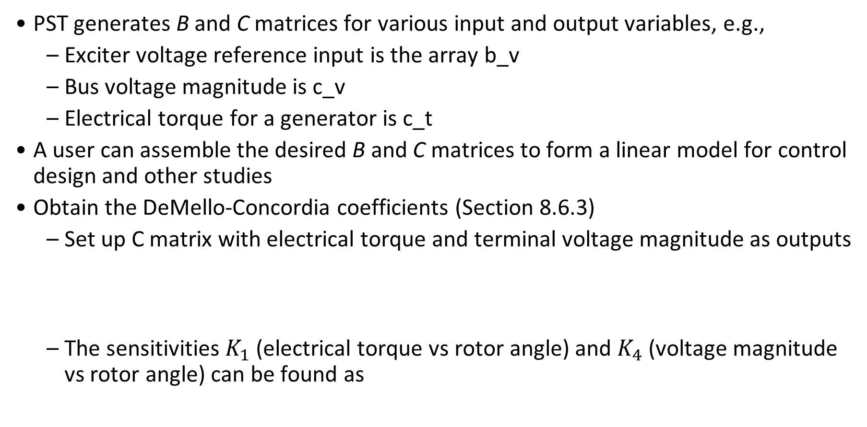
Linear Analysis Example
PST generates B and C matrices for various input and output variables, e.g.,
Exciter voltage reference input is the array b_v
Bus voltage magnitude is c_v
Electrical torque for a generator is c_t
A user can assemble the desired B and C matrices to form a linear model for control design and other studies
Obtain the DeMello-Concordia coefficients (Section 8.6.3)
Set up C matrix with electrical torque and terminal voltage magnitude as outputs
The sensitivities $K_{1}$ (electrical torque vs rotor angle) and $K_{4}$ (voltage magnitude vs rotor angle) can be found as

Slide 23
Getting PST
PST developed by Joe Chow (RPI), Kwok Cheung (GE Grid Solution), and Graham Rogers (Cherry Tree Scientific Software, retired from Ontario Hydro)
Program structure discussed in J. H. Chow and K. W. Cheung, “A toolbox for power system dynamics and control engineering education and research,” IEEE Transactions on Power Systems, vol. 7, no. 4, pp. 1559-1564,1992.
Download from Joe Chow’s website: MATLAB functions, data sets, and a user manual
No cost to users: password to decompress the MATLAB code will be provided

